Slide 1
Unsupervised Clustering of Animated Series Based on Ratings and Popularity Metrics
By Christofer Vega
Alyssa Sombrero
Notes:
Christofer
Hi! I’m [insert name] [and I am [insert name]] our topic is Unsupervised Clustering of Animated Series based on ratings and popularity metrics.

Slide 2
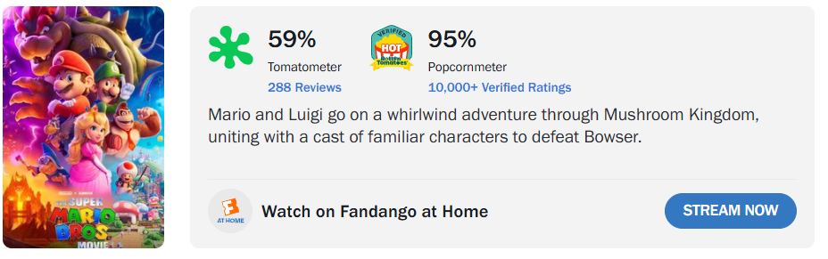
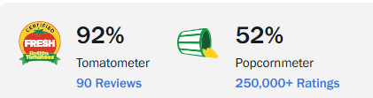
The Problem
Critics ratings do not align with the audience’s opinions of a animated show.
Some shows receive high ratings from the critics but aren’t popular among the standard audience.
Other shows receive low ratings from critics but high ratings from audiences
Our main goal is to identify the disconnection between critics and audiences ratings of animated media to understand how success is defined
Notes:
Christofer
(mention that the project is leaning towards Netflix for the time being)
The first rating is from The Super Mario Bros. Movie (Animated Movie from 2023)
The second rating is from the movie Antz from Dreamwork
(As you can observe in the following ratings, there are some differentiating opinions from critics and audiences.

Slide 3


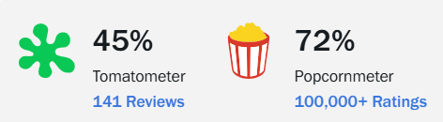



Examples
Notes:
Christofer
Maybe mention whats going on with the Maraio Galaxy

Slide 4

Bonus: What We Did Extra
Notes:
Alyssa
So to start off, we would to introduce the extra bonus feat we did to our project. If you are barely hearing about this topic and wanted to know what it is, don’t worry we got you.

Slide 5
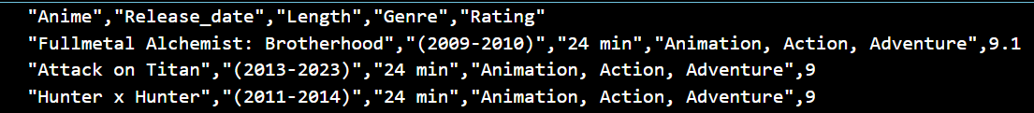

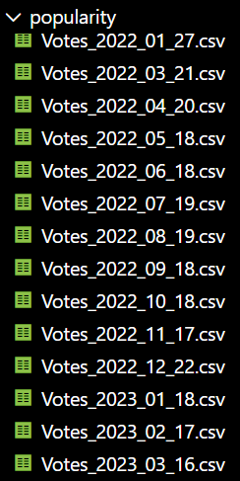
What we originally proposed
(anime.csv)
Load and Merge Preprocessed Datasets
Feature Engineering
Exploratory Data Analysis
Cluster
Interpretation
Visualization
Training K-Means Clustering Model
(Votes_2022_01_27l.csv)
(original workflow from 1st and 2nd presentation)
Originally, we proposed to utilize only K-means and another clustering algorithm to analyze animated media’s trends, audience behavioral pattern through rating systems, and study audience-critic disagreements. Our goal was to produce a simple output, from the algorithms, in hopes it’ll be enough information to study the data.
Notes:
Alyssa
So originally, we wanted to utilize a clustering model, with only a k-means algorithm and another type of algorithm to be applied, in order to analyze the anime ratings between critics and public. Our entire goal was to find any trends or patterns find audience-critic disagreements and any audience behavioral patterns, since there were most movies and cartoons done wrong by critics. So as you can see, here is the original workflow from the first and second presentation where we just originally wanted to just: load, merge the datasets, do some feature engineering, undergo exploratory data analysis, then be inputted into a k-means clustering model. From the model it’ll output visualizations and then its up for interpretation. And over here is the datasets we are mainly working with. The anime.csv came from IMBD (a place for hardcore critics) and the votes dataset by the public. As you can see we have a bunch of votes data. (OH and spoiler warning, the other type of algorithm was Gaussian Mixture Model so you’ll be seeing it frequently as well.)

Slide 6
What we did extra:
Implemented 3 additional algorithms:
BIRCH (Balanced Iterative Reducing and Clustering using Hierarchies)
  Groups large-scale popularity data into hierarchical clusters, useful for scalable analysis of anime engagement trends
HDBSCAN (Hierarchical Density-Based Spatial Clustering of Applications with Noise
  Extended by detecting clusters of various densities while automatically handling noise
DBSCAN (Density-Based Spatial Clustering of Applications with Noise)
  Identifies dense voting committees and isolates other anime titles with rating patterns
Due to additional algorithms, more visualizations, comparisons & pipelining were implemented
K-Means Algorithm
Load and Merge Preprocessed Datasets
Feature Engineering
Exploratory Data Analysis
GMM Algorithm
BIRCH Algorithm
Cluster
Interpretation
Visualization
Training Clustering Model
GMM Algorithm
(updated workflow)
BIRCH Algorithm
Notes:
Alyssa
Note: affirm that in the visual output slide, they will see the comparison of the the original implemented algorithms with the extra
Now here’s what we did as a bonus feature. We implemented 3 additional algorithms

Slide 7


Why it matters:
The extra work of implementing more algorithms (HDBSCAN, DBSCAN, BIRCH) helps advocate for a deeper analysis of anime rating behaviors since these algorithms were designed to handle highly uneven, noisy datas.
By comparing the outputs from DBSCAN, HDBSCAN, and BIRCH, there can be a deeper, better and cleaner analysis of the cluster density, outlier detection and audience’s behavior.
Notes:
Alyssa
These algorithms matter because naturally, voting data are noisy and uneven. So with more additional algorithms, we wanted to continue experimenting with it since they are designed for dense groups, outliers, and scalable clustering. Overall advocate a deeper interpretation of rating behavior.

Slide 8
Implementation Updates
Improved Working Code
Created a total of 5 algorithms: DBSCAN, HDBSCAN, BIRCH,
K-MEANS, GMM.
New command line argument for ‘--k’, ‘--find-k’, ‘--no-vis’.
Created more cluster algorithm reports.
Improved Running Pipeline
“Stitched” all outputs from all the algorithms.
Applied Config dictionary to make changes on model.
Sa Display final outputs and comparison fto web (index.html).
Implemented a showcase of data preprocessing stages.
Improved Trained Model
VAE (Variational Autoencoder) is implemented to reduce
complexity of the data set so it could visualized clearly
encode function to transform anime feature vectors into latent-space coords
train_vae_projection to initialize and train VAE model
Notes:
Christofer

Slide 9
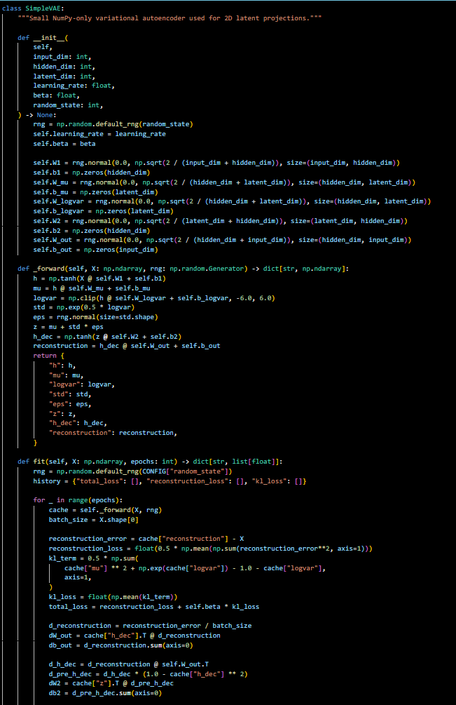
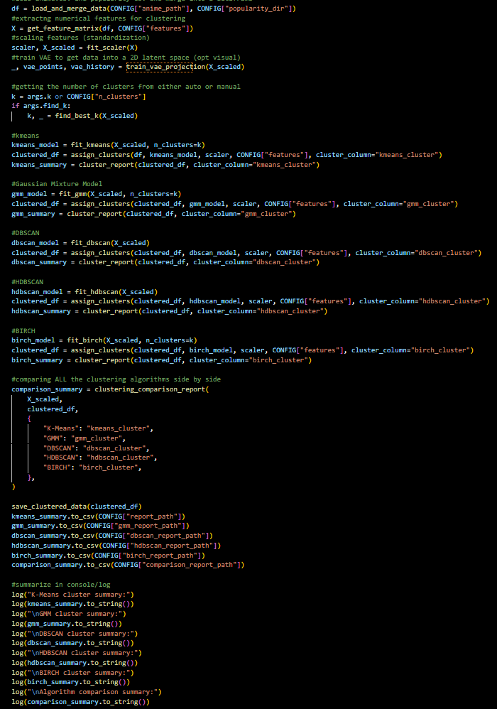
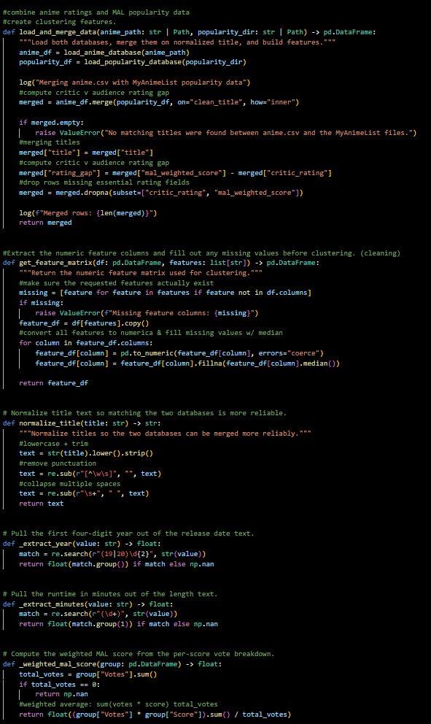
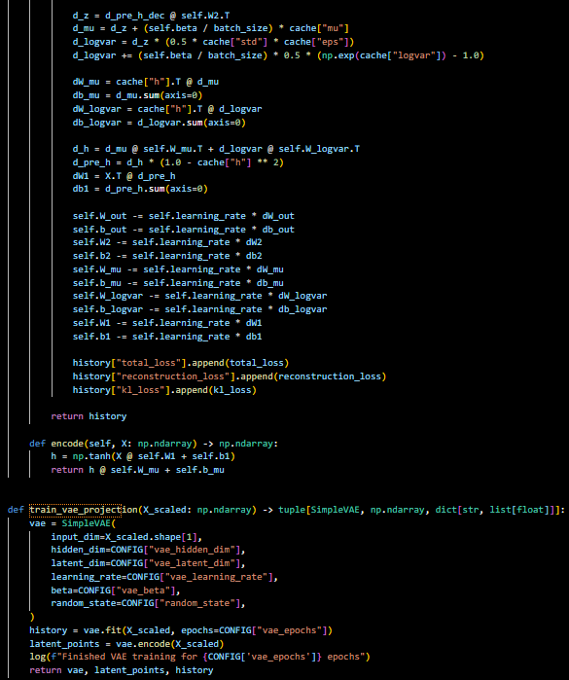
Working Program: Code
Working Main Code
Running Pipeline Code
Core Train Model Code
Notes:
Main code demonstrates the summary of workflow for the program itself.
The portion of the running pipeline code is use to show how the program “cleans” the data, extracts features, normalizes, and merge the datasets. It being readable to the model is the end product.
Show case the new version of training through VAE instead of PCA

Slide 10
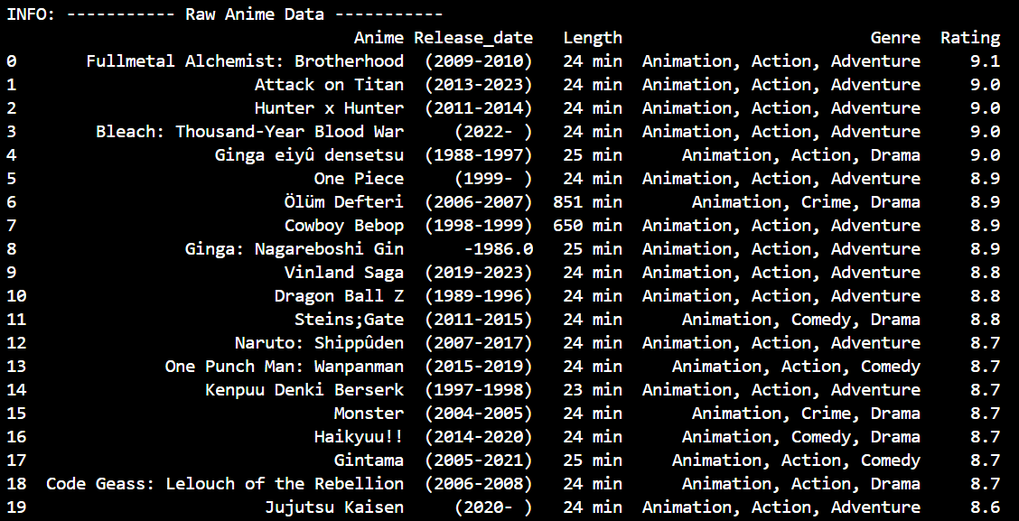
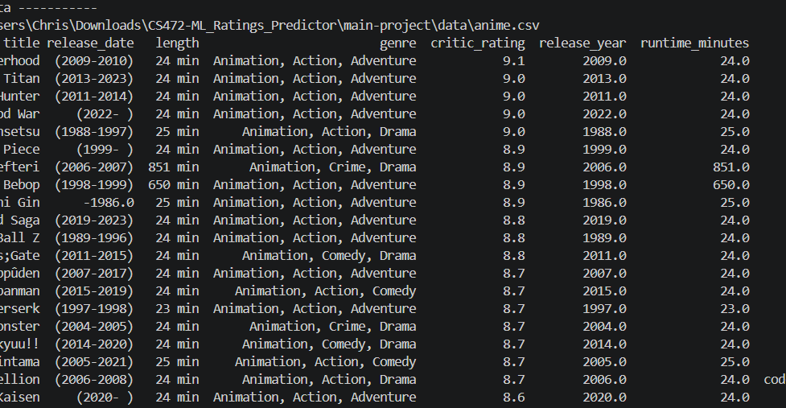
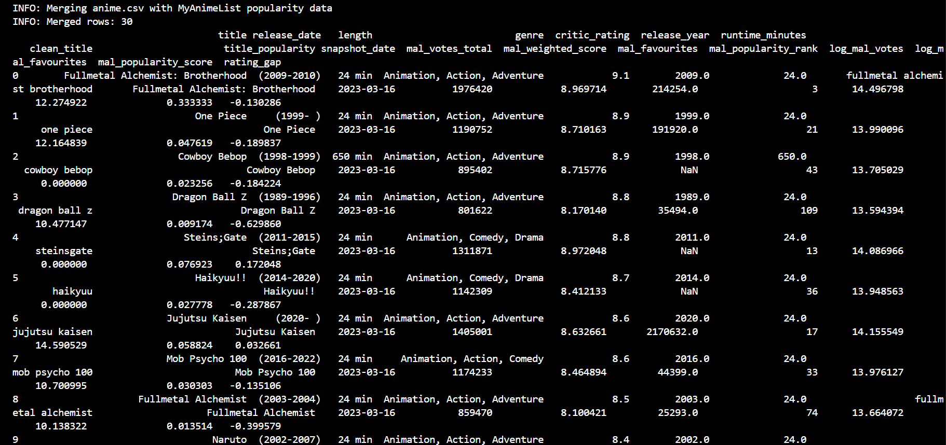
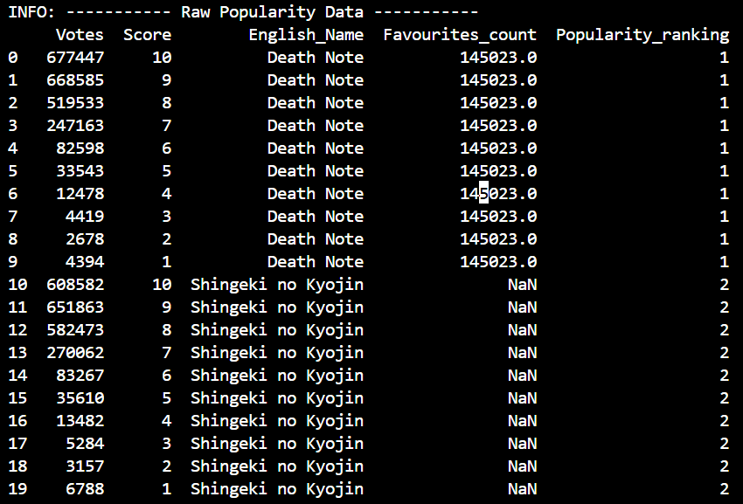
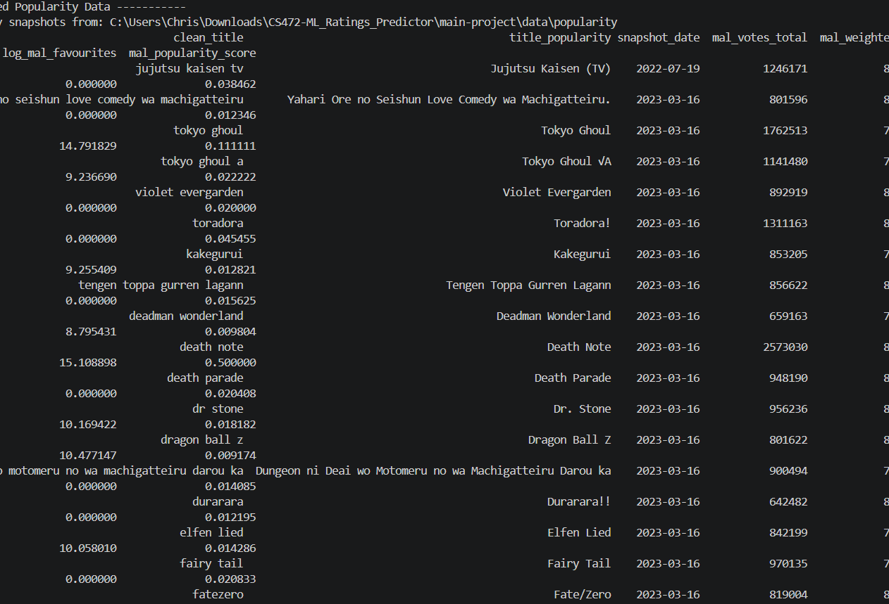
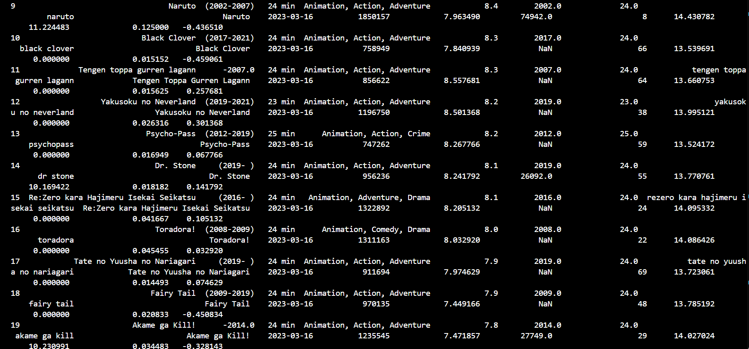
Data After Preprocessing
Raw Data Set
Cleaned Data Set
Processed Data Set
Python main.py - - raw
Running Pipeline Screenshot
Trained Model Screenshot
Python main.py - - clean
Python main.py - - preprocess

Slide 11
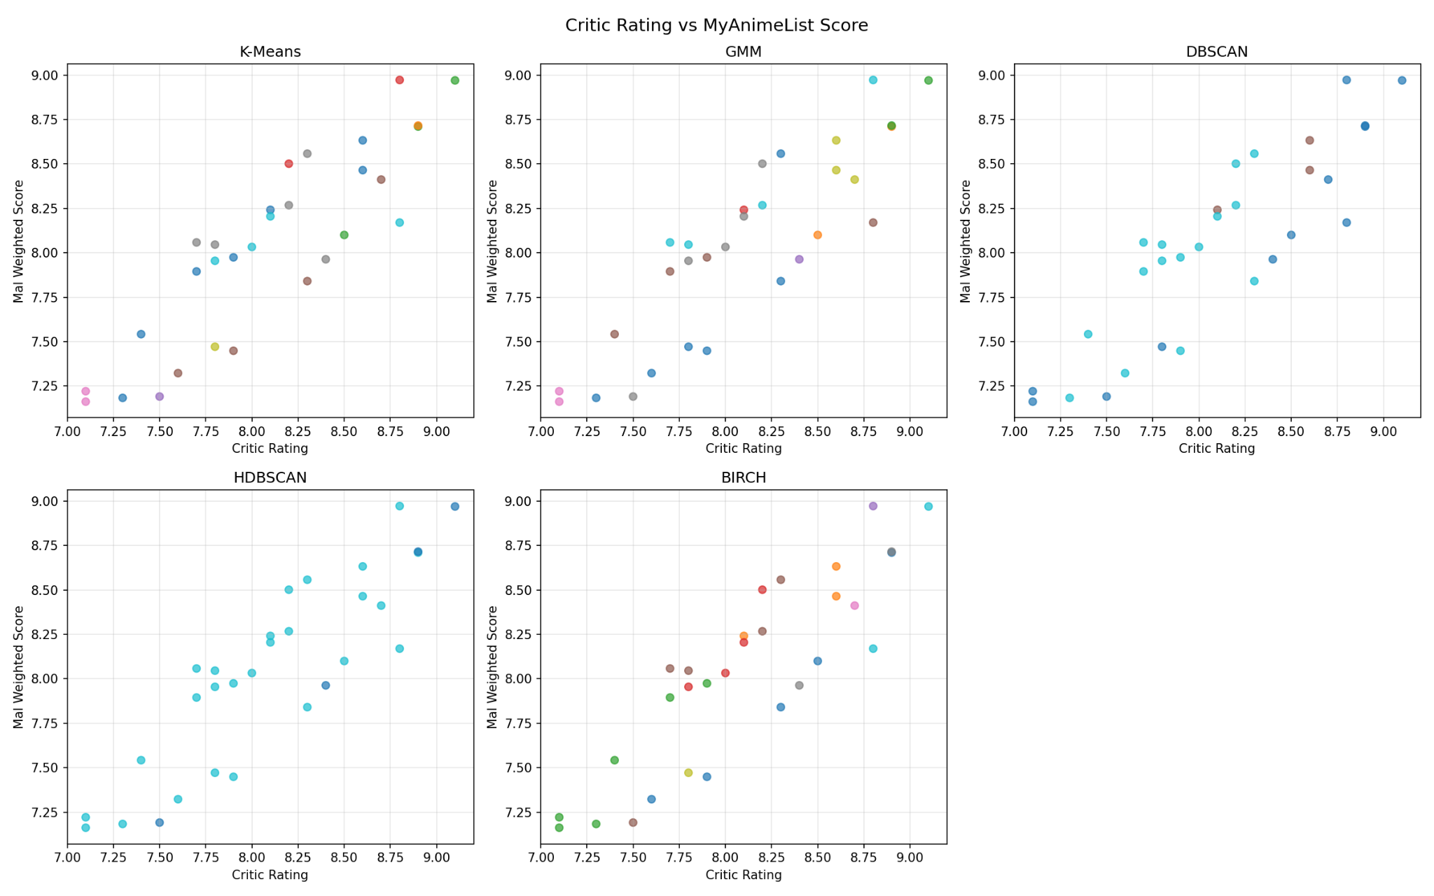
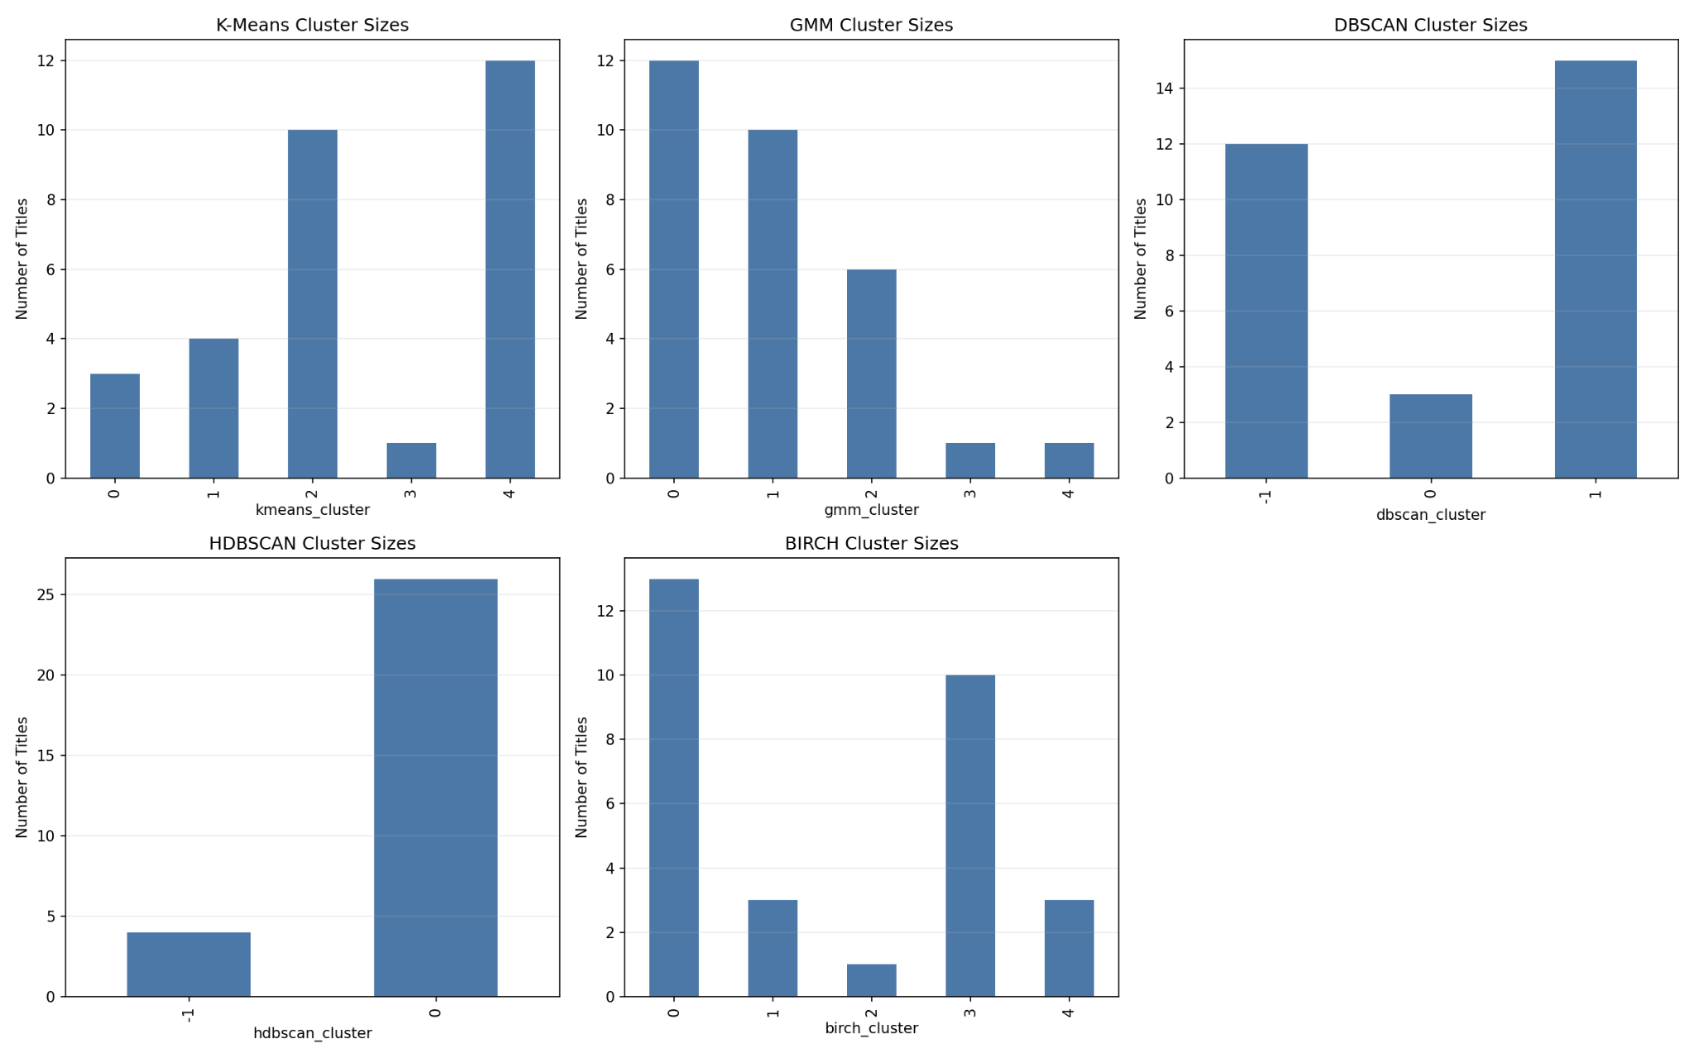
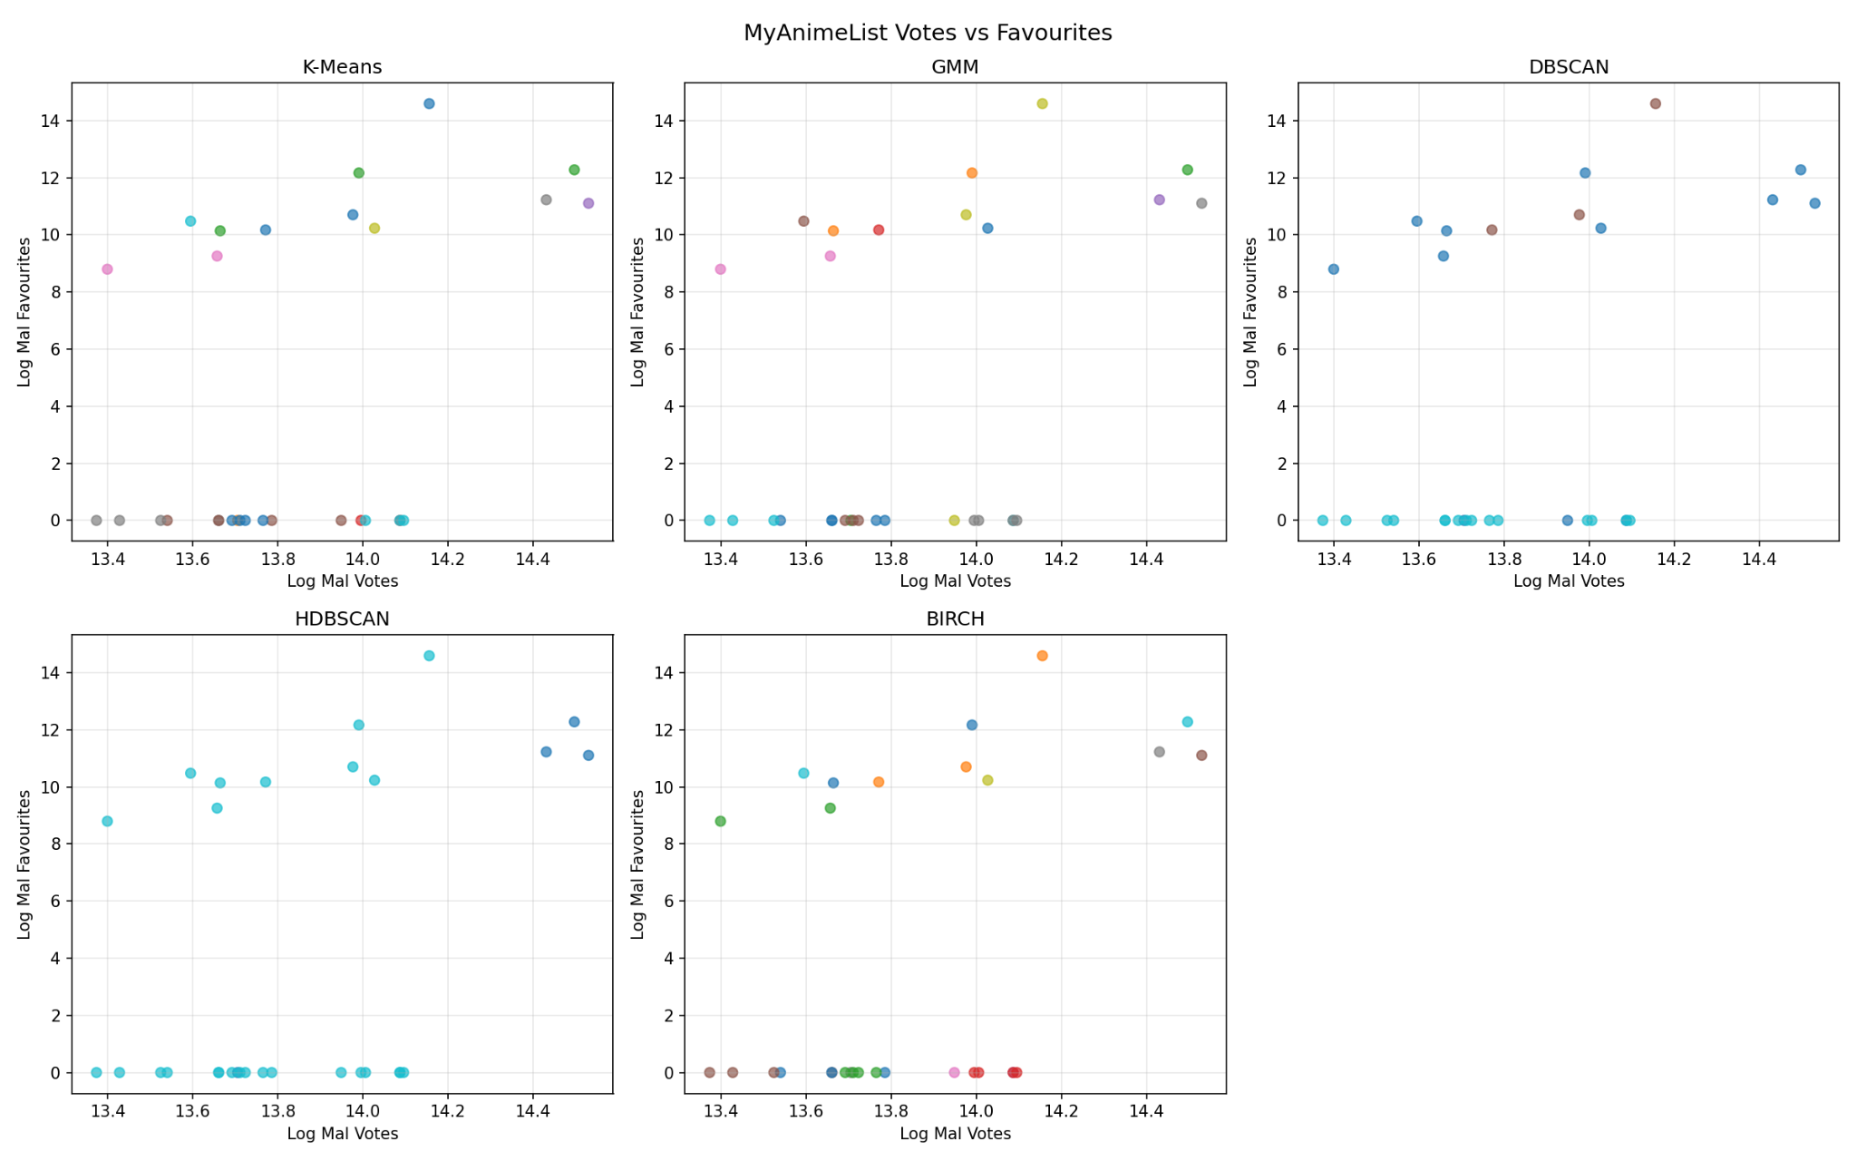
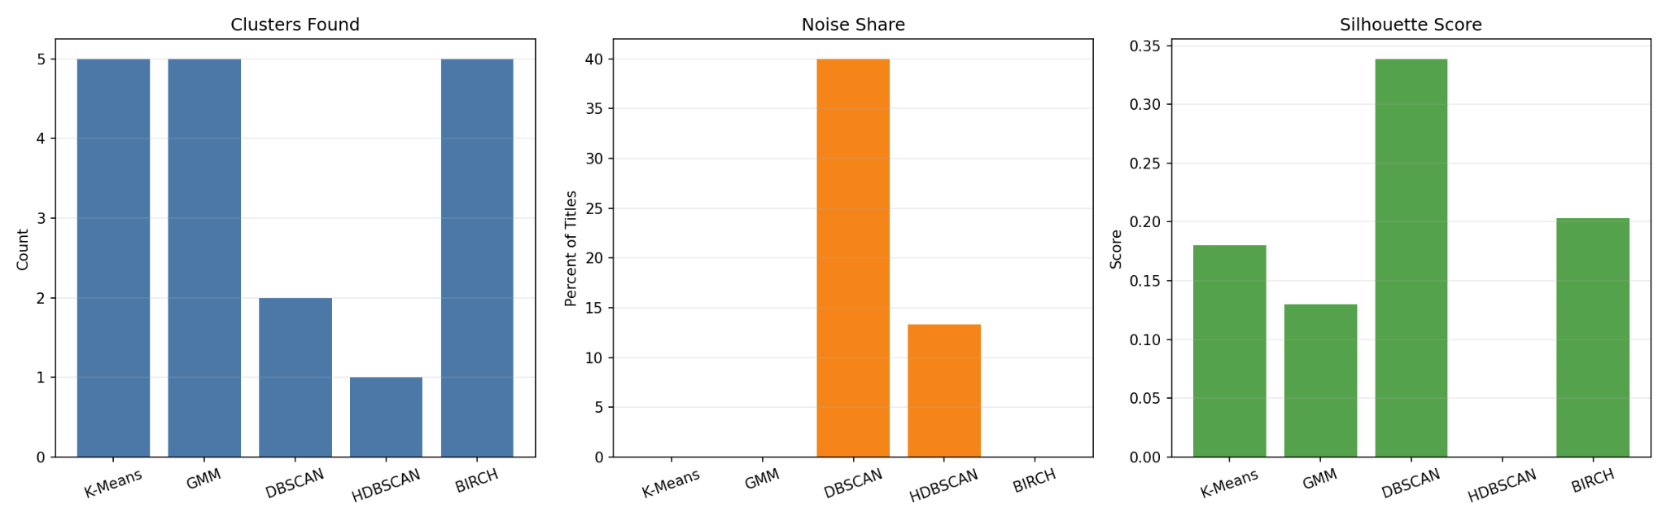
K = Best K
Visual Outputs
Notes:
Bar graphs shows changes, for some reason scatter plots won’t show changed even though they were modified by the code.
Teh values we are dealing with are stataic, hence why the scatter plots stays the same.

Slide 12
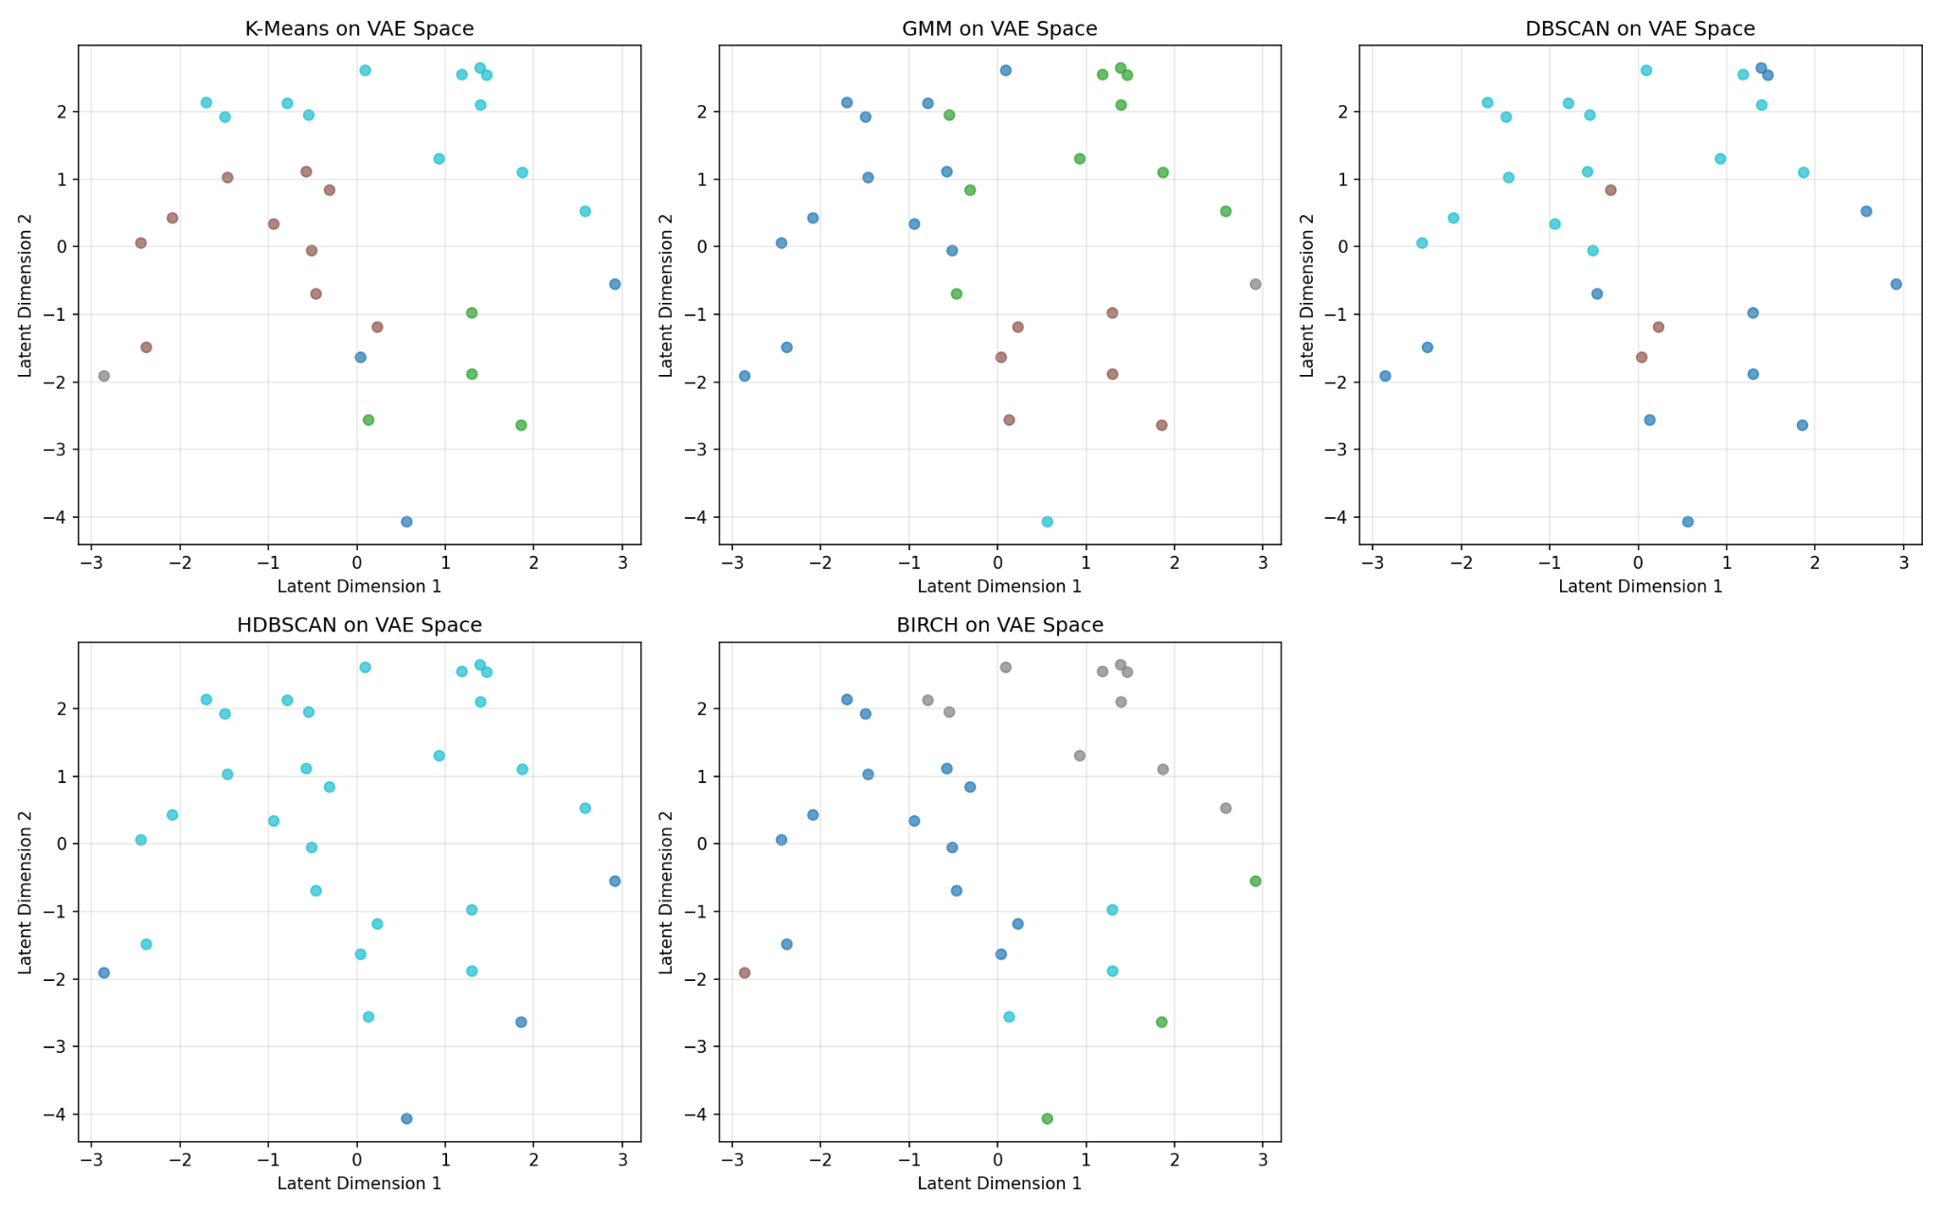
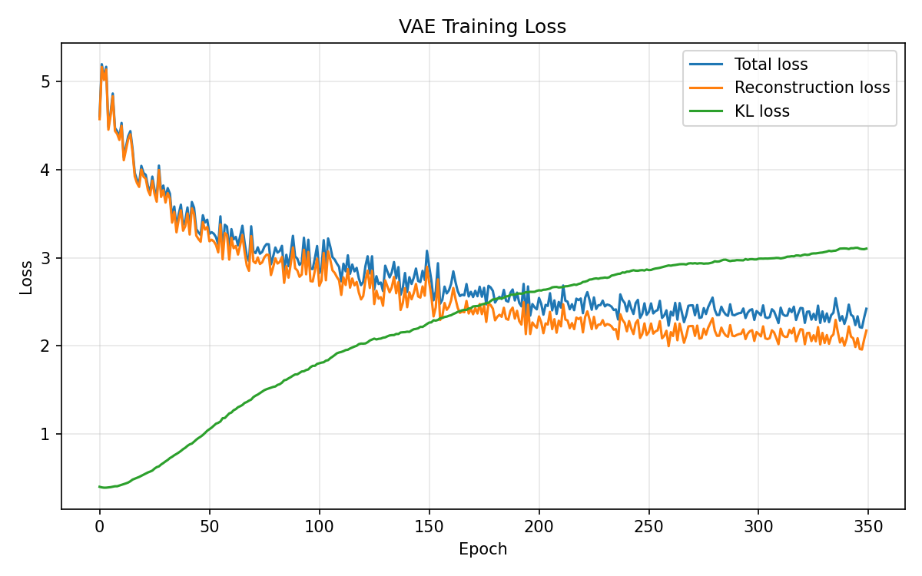
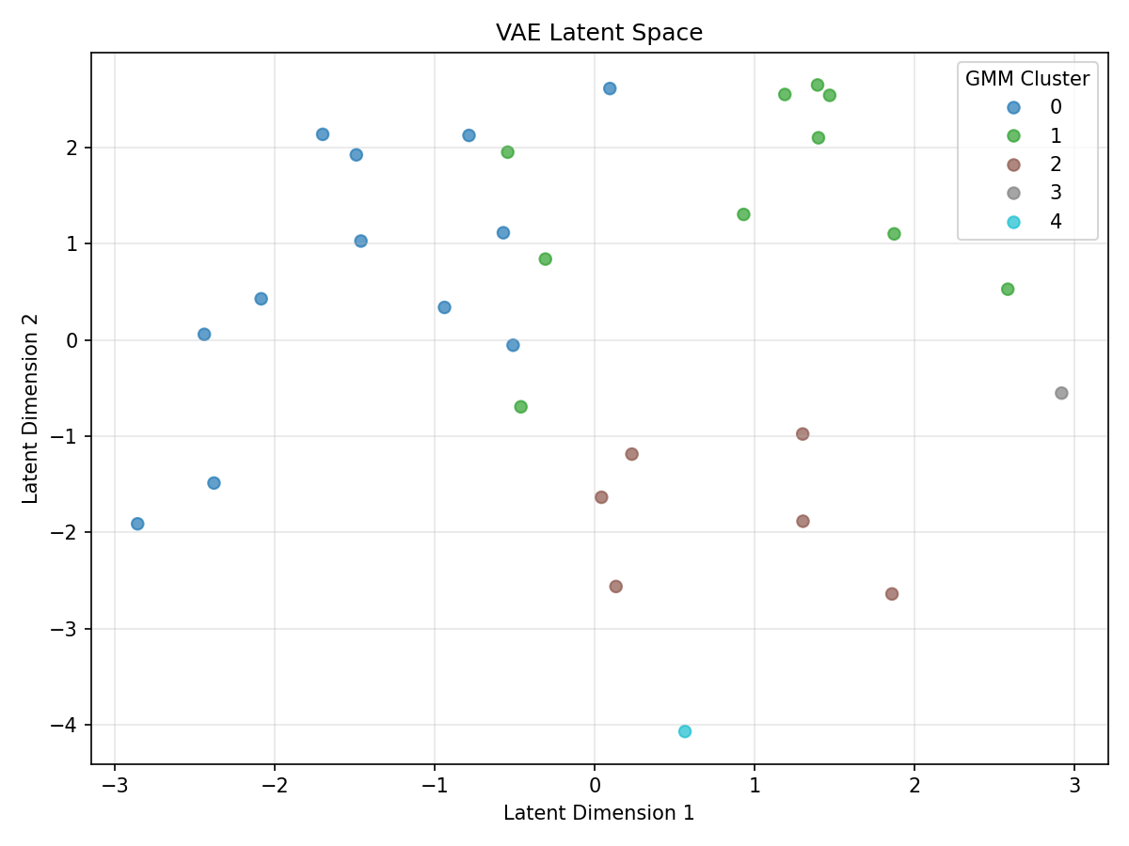
K = Best K
Visual Outputs
Notes:
Bar graphs shows changes, for some reason scatter plots won’t show changed even though they were modified by the code.
Teh values we are dealing with are stataic, hence why the scatter plots stays the same.

Slide 13
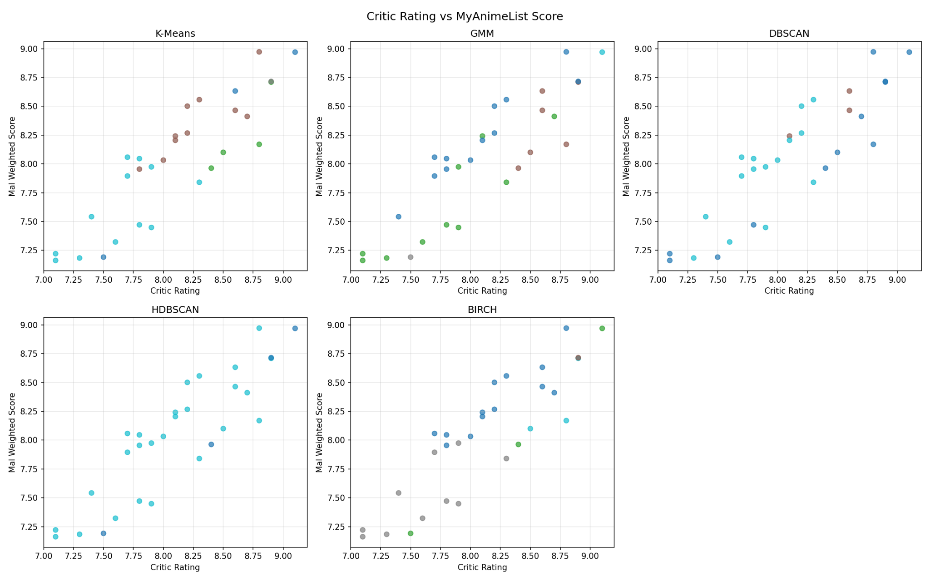
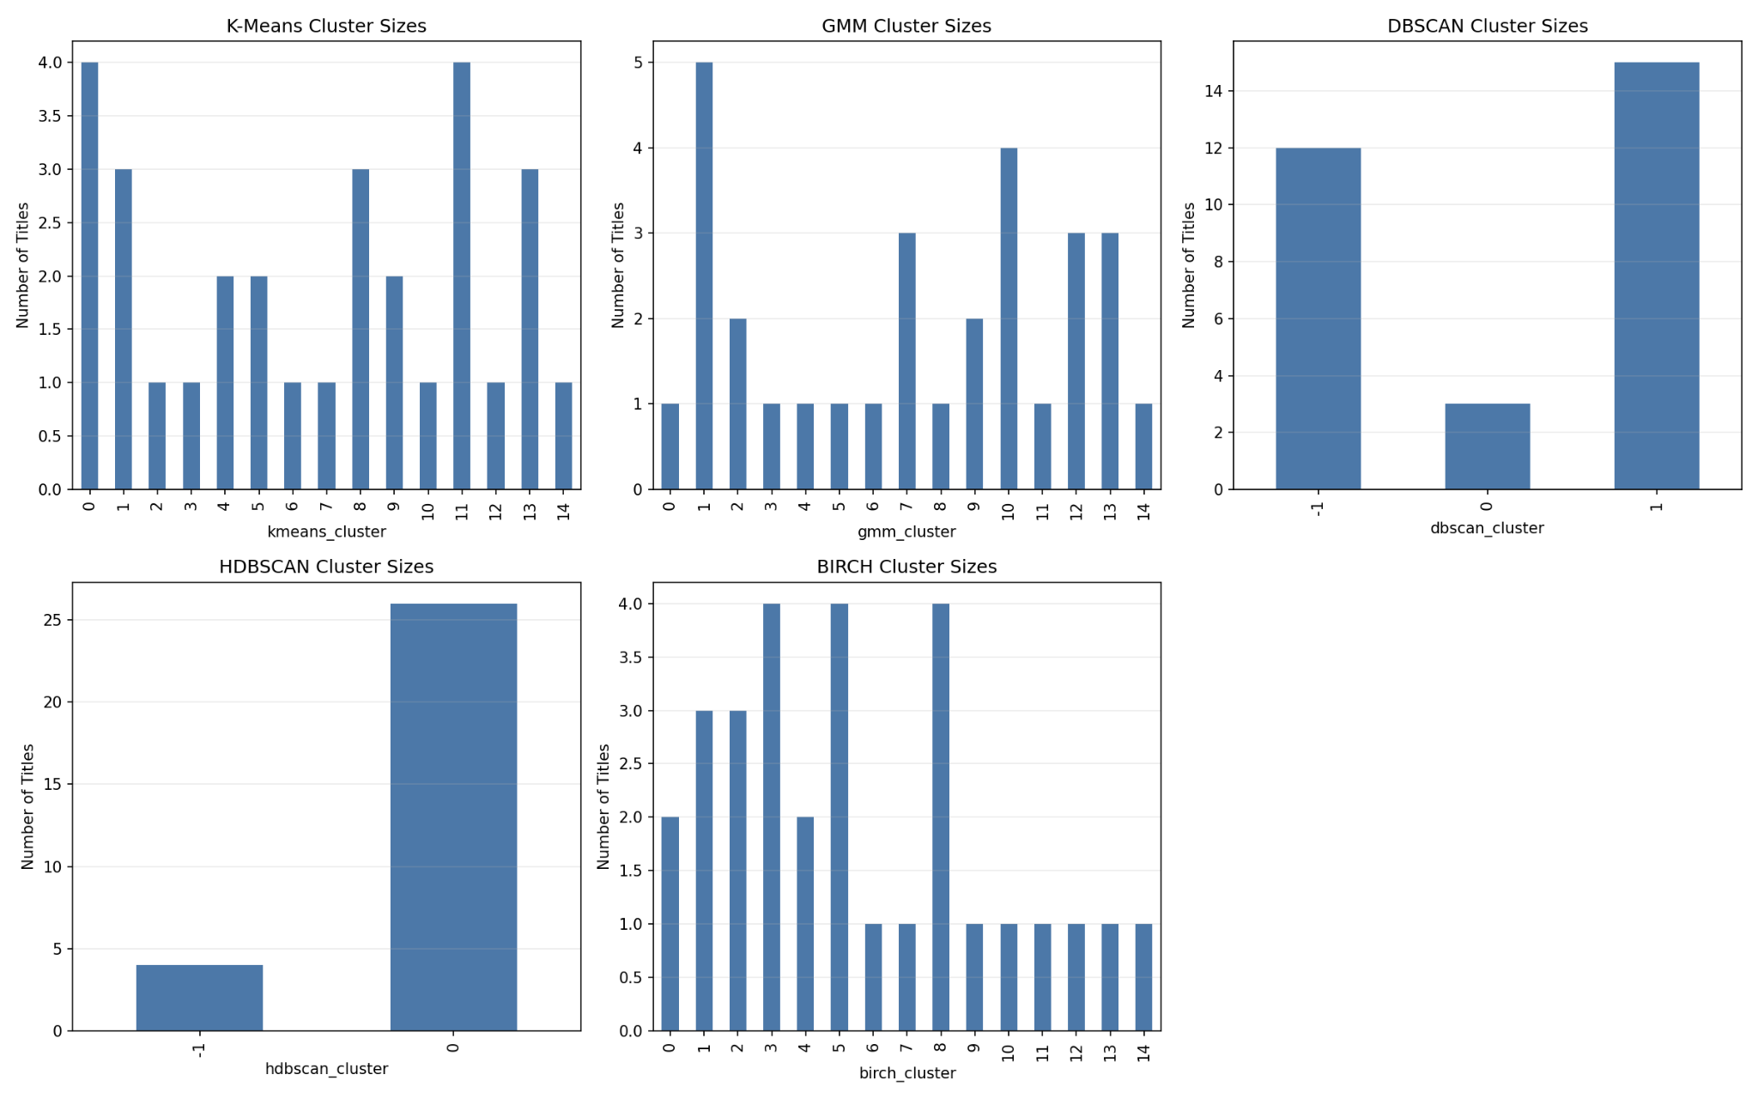
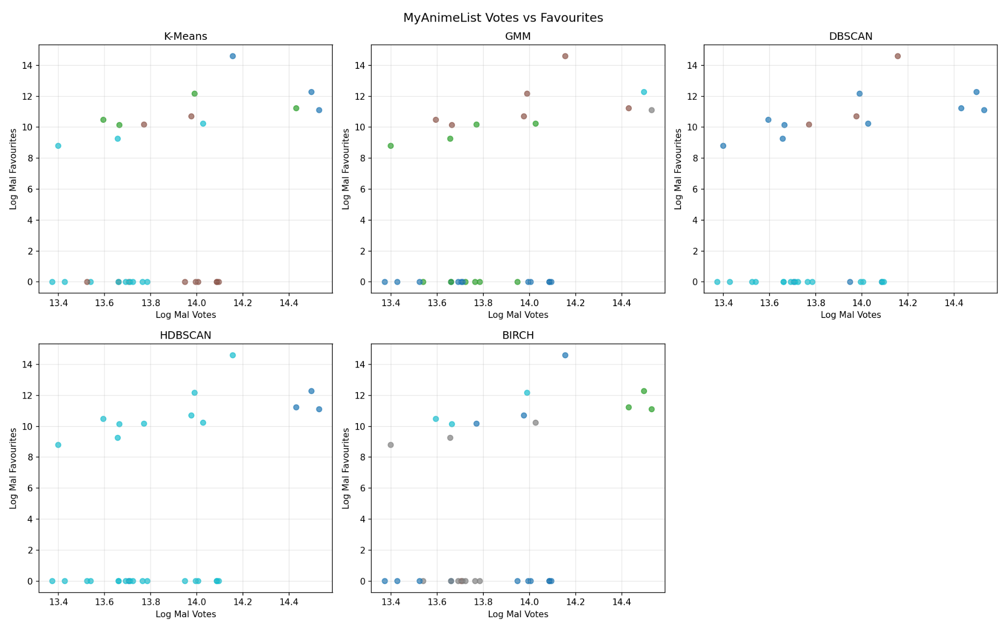
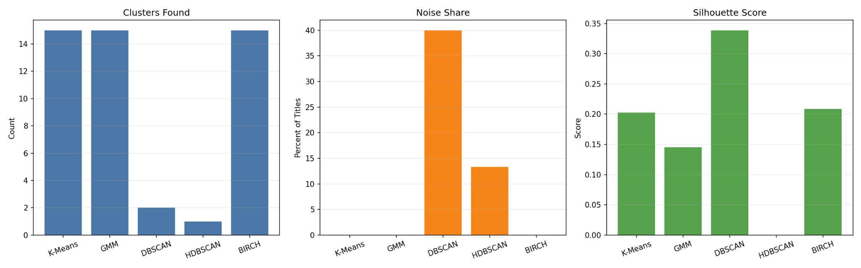
K = 15
Visual Outputs
Notes:
Aside from the scatterplot seen in a consistent structure, the colors are different meaning the data is being grouped differently.

Slide 14
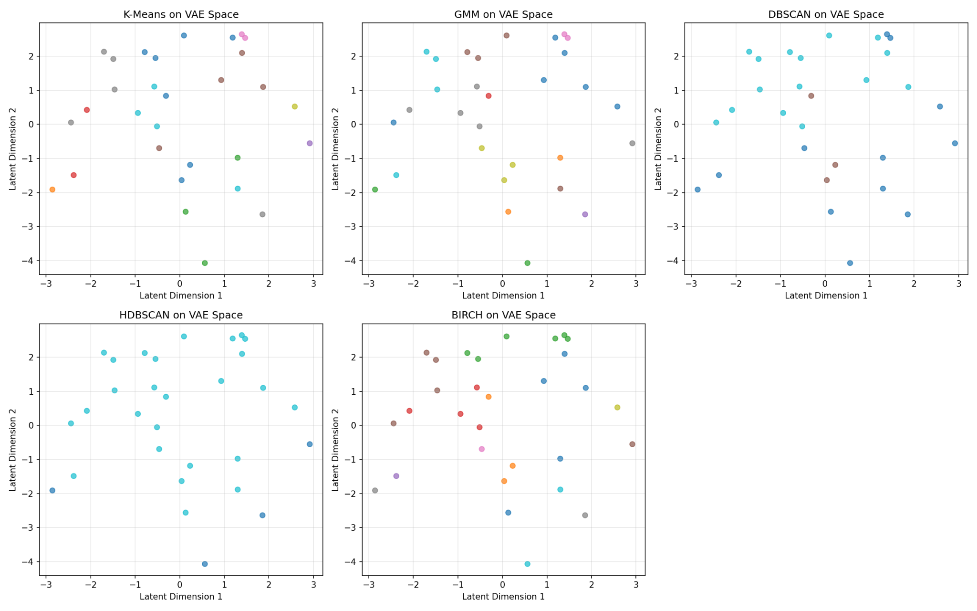
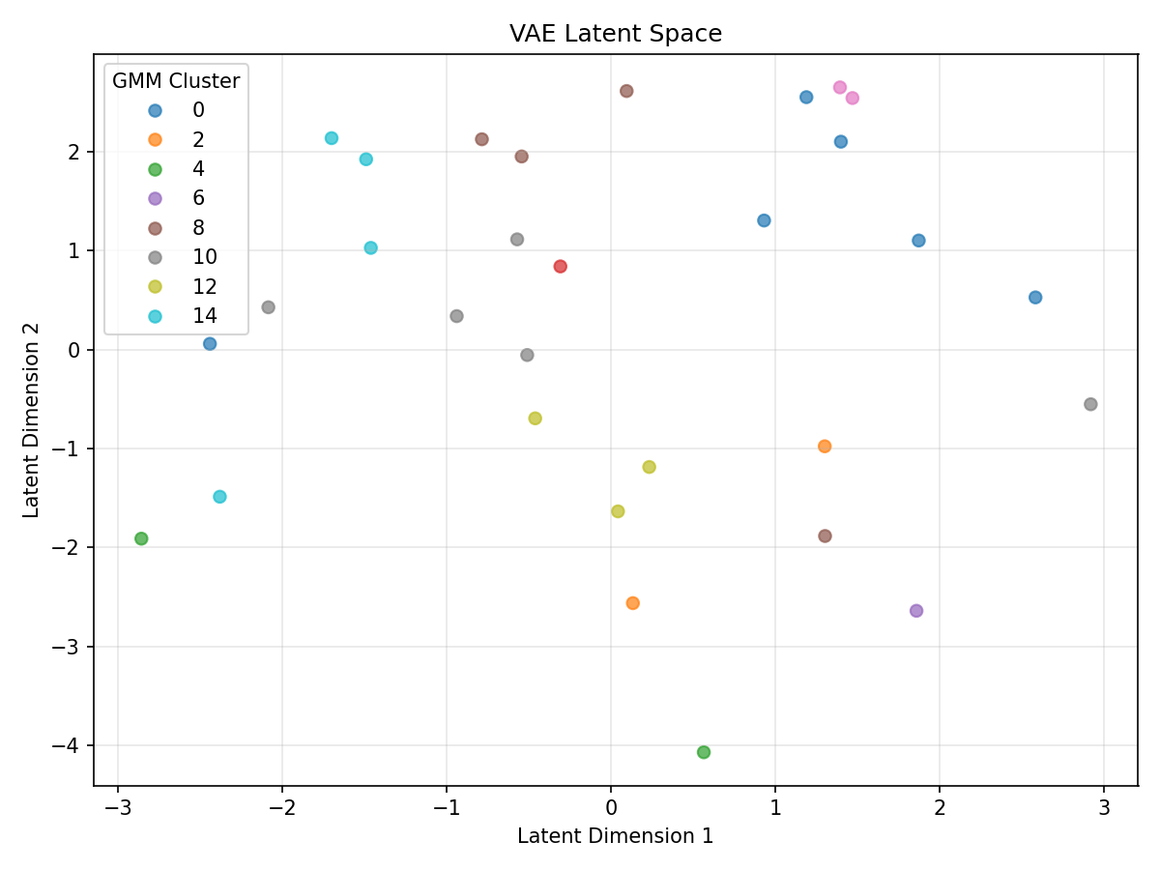
K = 15
Visual Outputs
Notes:
Aside from the scatterplot seen in a consistent structure, the colors are different meaning the data is being grouped differently.

Slide 15
Initial Experimental Results
Cluster Visualization | Metric Scores (MAL - Critics) | Qualitative Findings
Well Regarded by Critics and MAL | 0.14 | Re:Zero, Steins;Gate, Toradora!
Recent high-rated/ mainstream | 0.01 | Jujutsu Kaisen, Dr.Stone
Classic with high critic | -0.18 | Cowboy Bebop
Divisive Series | -0.16 | Fairy Tail, Akame Ga Kill!
Iconic/ Long running franchises | -0.41 | One Piece and Dragon Ball Z
Universally acclaimed master-piece | -0.13 | Fullmetal Alchemist: Brotherhood
The remaining questions are:
How would the clusters look like if we had used different open-source critic sources (Rotten Tomatoes)?
Would a bigger dataset with more anime titles affect the overall spread of the clusters?

Slide 16
GitHub Repository
GitHub Repository Link:
https://github.com/CocoCat0/ML_Anime_Ratings_Predictor
GitHub Report Webpage:
https://cococat0.github.io/ML_Anime_Ratings_Predictor/main-project/output/index.html
Notes:
So here’s our github repository. It is now public so if you want to play around with the machine learning model you can. Also very cool thing about this is when you run the main.py and get new outputs, all the outputs will reported onto the GitHub Report Webpage.

Slide 17

Thank you!
Any Questions or Feedback?
Notes:
Thank you!
algorithm and datasets

